Slide 1
Dimensionality Reduction Methods for Spectral Analysis
Sergei V. Kalinin

Slide 2
Linear Unmixing methods
Why linear unmixing?
Spectral images
Image analysis
Multiple linear regression
Principal component analysis (PCA)
Definition and implementation
PCA for scanning tunneling microscopy
Physical meaning of PCA: band excitation SPM
PCA on imaging data
Independent component analysis (ICA)
N-FINDR and Bayesian linear unmixing
Mapping phase transitions
Image segmentation
Physical constraints in linear models: If solution exists and its unique, doesn’t matter how you find it
Notes:
For recording – remove figures

Slide 3
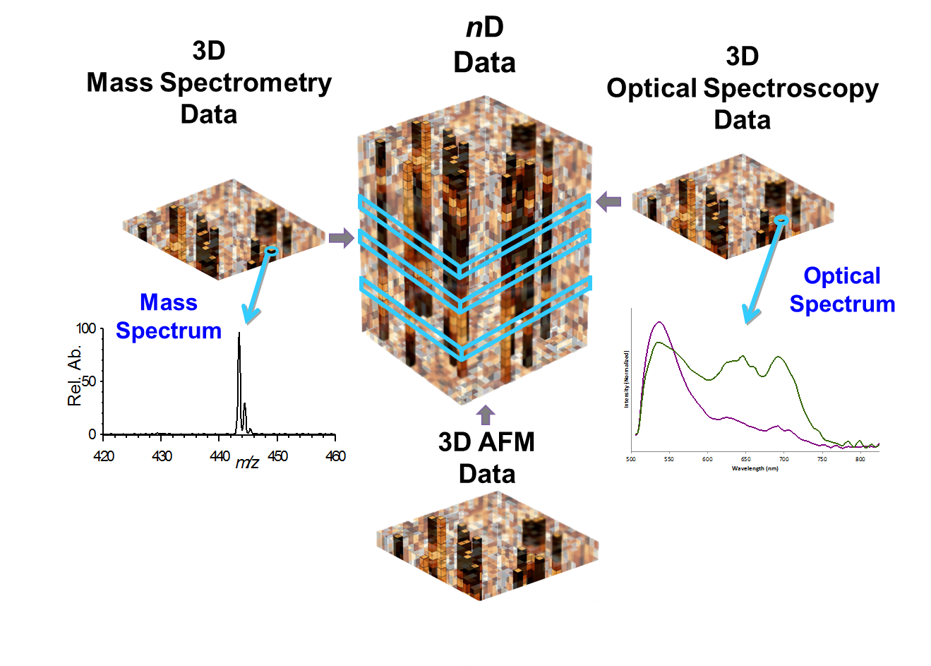
Spectroscopic Imaging
Advancements in imaging led to a broad spectrum of the spectroscopic imaging techniques, in which response spectra are measured in each spatial location giving rise to 3- and higher dimensional data.
Scanning probe microscopy:
Force-distance curve measurements
Current-voltage measurements
Piezoresponse force/electrochemical strain spectroscopy
Electron microscopy:
Electron Energy Loss Spectroscopy
Optical microscopy:
Hyperspectral imaging
Time resolved measurements
Figure by S. Jesse
Mass-spectrometry:
Secondary ion MS imaging
In many cases, measured signal can be represented or approximated as a linear combination of signals. However, their functional forms are generally unknown
Very important: convolution with resolution function is also mixing

Slide 4
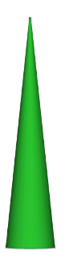
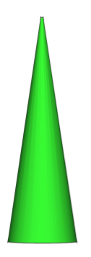
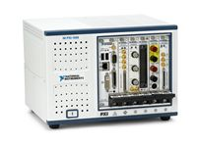
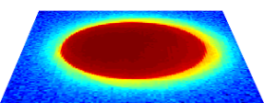
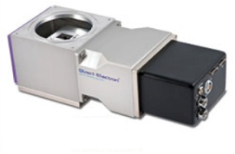
Less obvious cases
1. Ptychography in STEM
3. Image analytics
electron beam
Sub-Å probe
To scan control coils
N
Specimen
Advanced
DAQ
Figure by M. Ziatdinov
Sliding image transforms:
Fast Fourier Transforms
Correlation functions
Intensity histograms
Structural descriptors
Direct
Electron
Detection
Collected is diffraction pattern (ronchigram) in each location
2. Focussed X-Ray
Collected is diffraction pattern in each spatial location in 2D or 3D
The M pixel 2D image is transformed to M/N pixel image of more complex structure
Notes:
Please ask Alex Belianinov about image

Slide 5
Physics vs. ML based analysis
Physical model
Machine learning
If we have physical model, we can extract relevant parameters from data
Model can be imperfect – epistemic uncertainty
Data can be noisy – aleatoric uncertainty
Analysis results do not depend on sampling of data
If we don’t have physical model, we can learn intrinsic structure of data
Unsupervised learning: based on data only
But not really (definition of distance)
Analysis results can depend on sampling of data
Supervised learning: based on examples of prior data
Out of distribution shifts
Analysis does not affect on sampling of the data
Physics-informed ML: Combines strengths (and limitations) of both approaches

Slide 6
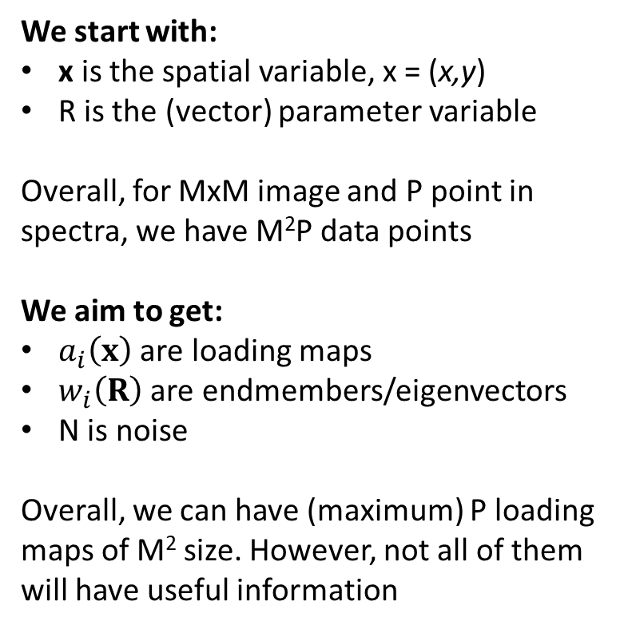
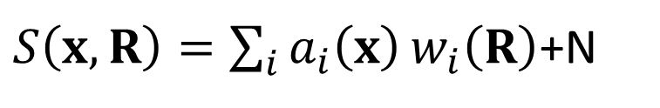
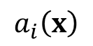
General linear unmixing
$S\left(x,R\right)=\sum_{i}{a_{i}\left(x\right)}w_{i}\left(R\right)$+N
$$a_{i}\left(x\right)$$
We start with:
x is the spatial variable, x = (x,y)
R is the (vector) parameter variable
Overall, for MxM image and P point in spectra, we have M²P data points
We aim to get:
$a_{i}\left(x\right)$ are loading maps
$w_{i}\left(R\right)$ are endmembers/eigenvectors
N is noise
Overall, we can have (maximum) P loading maps of M² size. However, not all of them will have useful information
w_{i}
Figure by S. Jesse
R

Slide 7
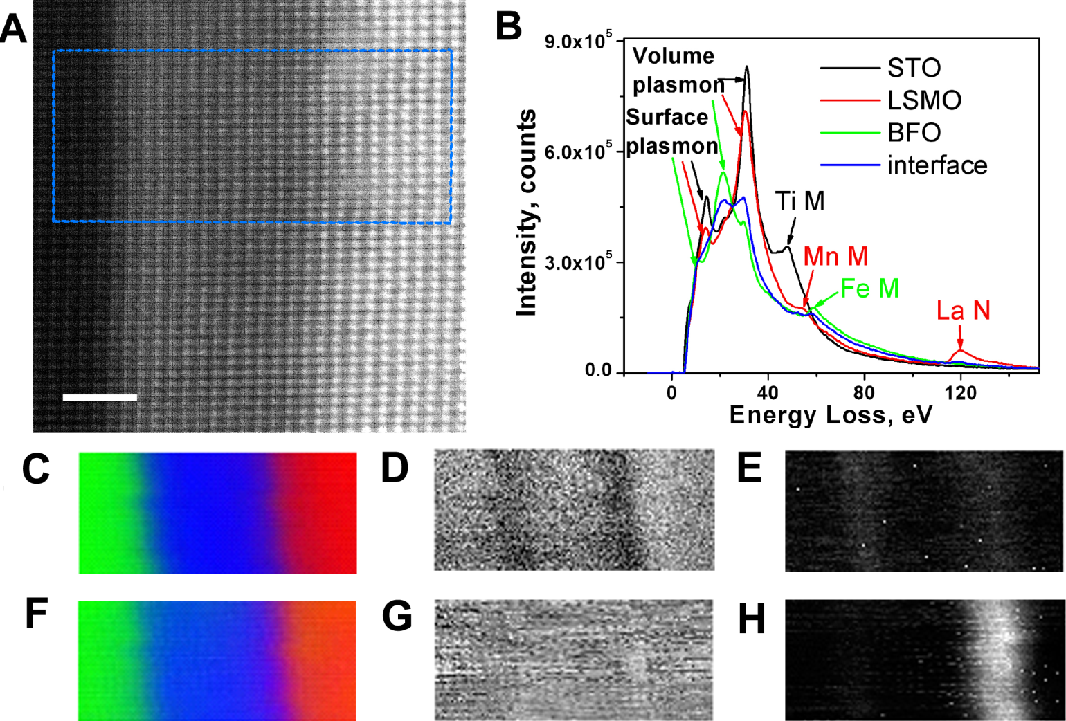

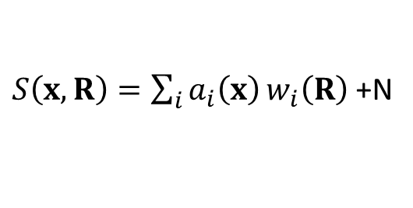

Multiple Linear Regression
Linear mixing
$S\left(x,R\right)=\sum_{i}{a_{i}\left(x\right)}w_{i}\left(R\right)$ +N
but $w_{i}\left(R\right)$ are known
STEM of STO/LSMO/BFO interface
Low-loss EELS spectra of three components
A.Y. Borisevich et al, Suppression of Octahedral Tilts and Associated Changes in Electronic Properties at Epitaxial Oxide Heterostructure Interfaces, Phys. Rev. Lett. 105, 087204 (2010).
Standard spectra
Fit coefficient map
residuals map
χ2 map
“Chemistry”:
35 to 125 eV
“Plasmons”:
5 to 35 eV

Slide 8
But what if endmembers are unknown?
At the first glance, the problem is impossible. We want to separate mixture in the components without knowing what the components are!
What we can do:
Principal component analysis: how many components are there in the mixture
Independent component analysis: going against the law of big numbers
Bayesian linear unmixing: additivity to 1 and non-negativity constrains
What can be done:
Bayesian linear unmixing: constraints on endmembers
Sparse reconstructions: small number of components in each point
Constraints on loading maps: smoothness or sharp boundaries
Kernel transforms: data is simplest if physics is correct
Notes:
Need to change images – likely copyrighted

Slide 9
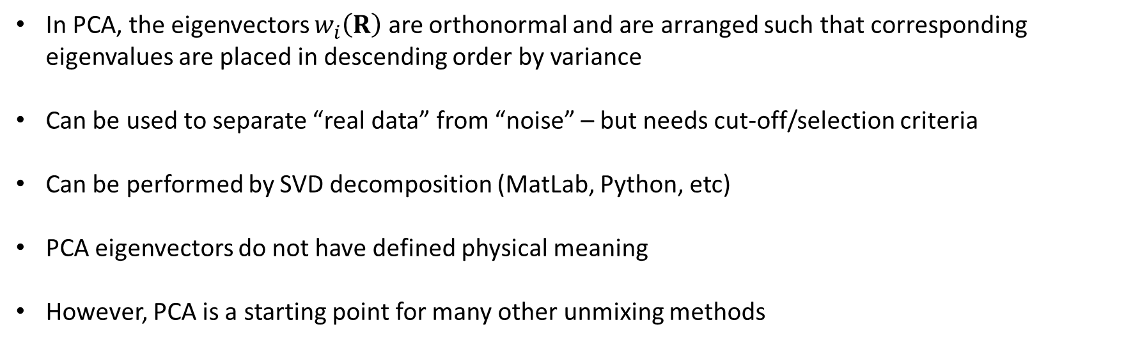
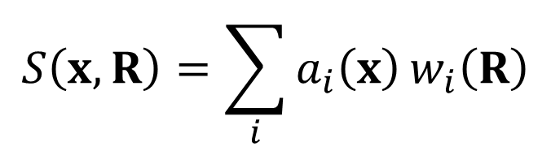
Principal Component Analysis
$$S\left(x,R\right)=\sum_{i}{a_{i}\left(x\right)}w_{i}\left(R\right)$$
In PCA, the eigenvectors $w_{i}\left(R\right)$ are orthonormal and are arranged such that corresponding eigenvalues are placed in descending order by variance
Can be used to separate “real data” from “noise” – but needs cut-off/selection criteria
Can be performed by SVD decomposition (MatLab, Python, etc)
PCA eigenvectors do not have defined physical meaning
However, PCA is a starting point for many other unmixing methods

Slide 10
PCA Background
PCA: orthogonal transformation converting possibly correlated variables into linearly uncorrelated principal components
PCA was invented by Karl Pearson in 1901, however the Singular Value Decomposition was independently derived some half a century earlier in Italy, Germany and France
PCA transforms the data such that the greatest variance by any projection lies on the first coordinate
Reveals internal structure of the data that best explains variance in the data set
Since data often moves in clusters, PCA reveals those variables that drive the variance
Pearson, K. (1901). "On Lines and Planes of Closest Fit to Systems of Points is Space". Philosophical Magazine Series 6 2 (11): 559–572

Slide 11
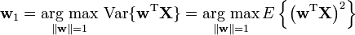
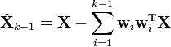
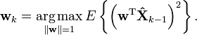
PCA: Formal Definition
Principal component w₁ of a data set X can be defined as:
Subsequent components k, can be found by simply subtracting k-1 components from the data
And substituting as Ẋ_{k-1} a new data set

Slide 12
PCA in Python…
… is really simple – we will see in the Colab. However, it is important to understand what is that we are doing!

Slide 13
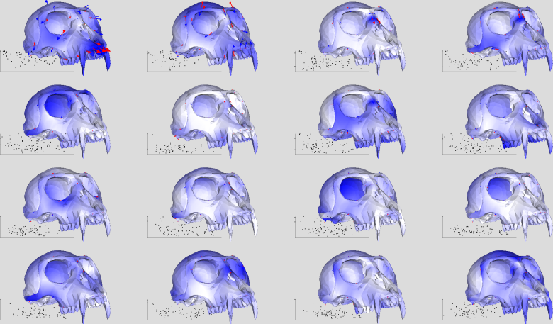
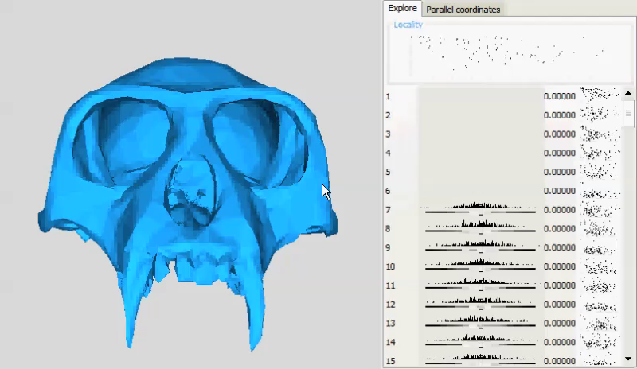
PCA: outside of imaging
Dan Alcantra, Localized Components Analysis, http://idav.ucdavis.edu/~dfalcant/research/loca.php
Great, quick tool for looking at multichannel data
Spectroscopic, or any type of series data becomes superposition of orthogonal eigenvectors with different weights
First eigenvector contains the most information within spectral dataset
Second eigenvector contains the most common response after subtraction of the 1st etc.
D. Alcantara, O. Carmichael, E. Delson, W. Harcourt-Smith, K. Sterner, S. Frost, R. Dutton, P. Thompson, H. Aizenstein, O. Lopez, J. Becker, and N. Amenta, "Localized Components Analysis", Proceedings of IPMI, 2007, pp. 519 - 531

Slide 14
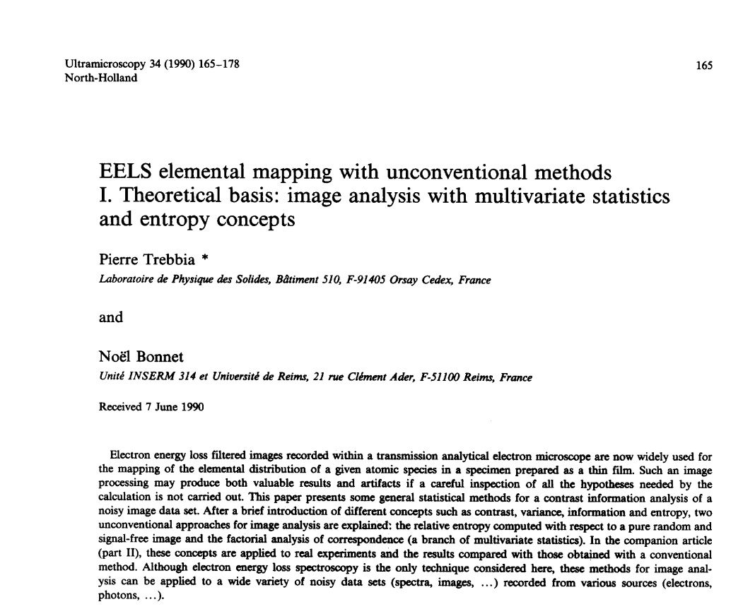
Why should we look at the historical papers:
Often contain elementary introductions
Deep insights into principles
Surprisingly prescient predictions
Comparison with the present: see th ebig picture
““Those who cannot remember the past are condemned to repeat it.”
George Santayana,
The Life of Reason, 1905

Slide 15
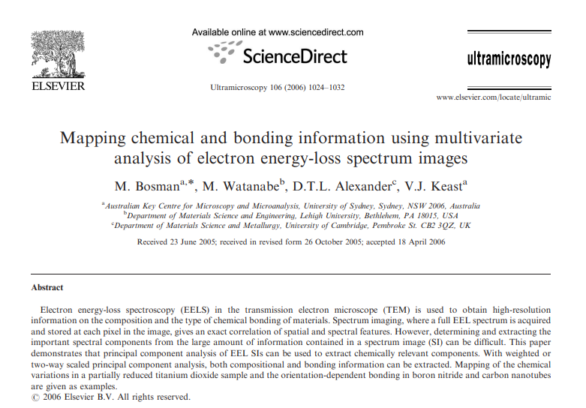
Why did the PCA on EELS started to grow in 2005 – 2010?

Slide 16
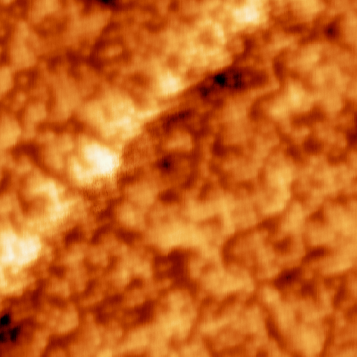
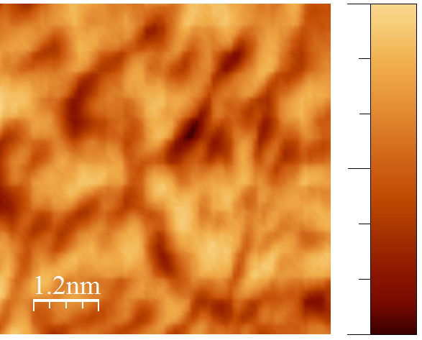
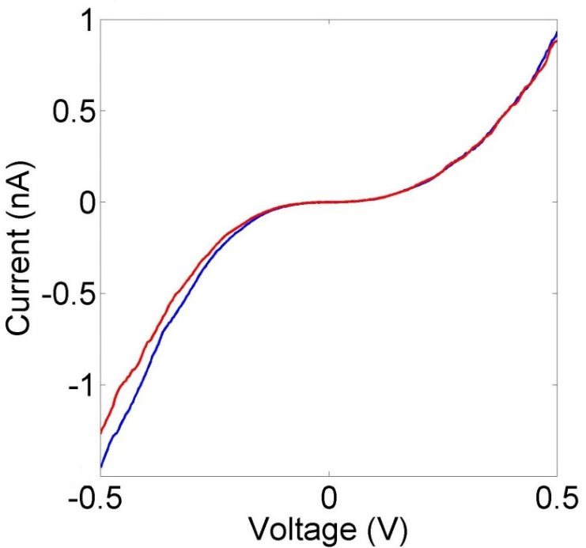
Grain boundary by STM
72pm
Topographical STM of FeSeTe, T = 82K 15x15nm², 50mV, 100pA, white rectangle represents area where CITS was performed; (b) CITS 80x80 pixel graphical average of the spectrographic data.
3.6 nm
1.4 nm
-106pm
10
M. Ziatdinov, A. Maksov, L. Li, A. Sefat, P. Maksymovych, and S.V. Kalinin, Deep data mining in a real space: Separation of intertwined electronic responses in a lightly-doped BaFe₂As₂, Nanotechnology 27, 475706 (2016).
1.4
1
Pixel
0.4
1
-0.5V
Voltage (V)
0.5V
4

Slide 17
Eigenvectors and loadings
Figure by A. Belianinov

Slide 18
Scree plot and correlations
Semi log plot indicating the “weight” of each component as a function of all components
Only the first few components contain useful info, while others are dominated by noise
We can also analyze correlations in images
For AFM data
PCA Eigenvectors
Spatial correlations
Figure by A. Belianinov

Slide 19
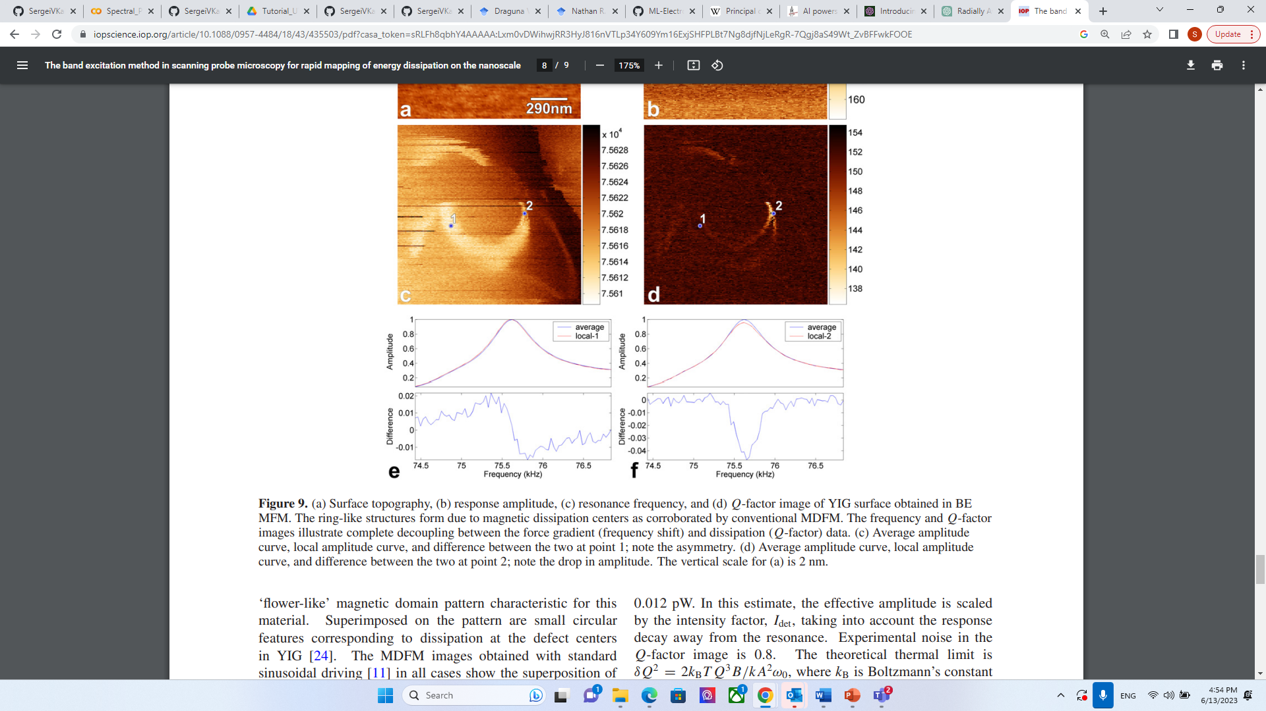
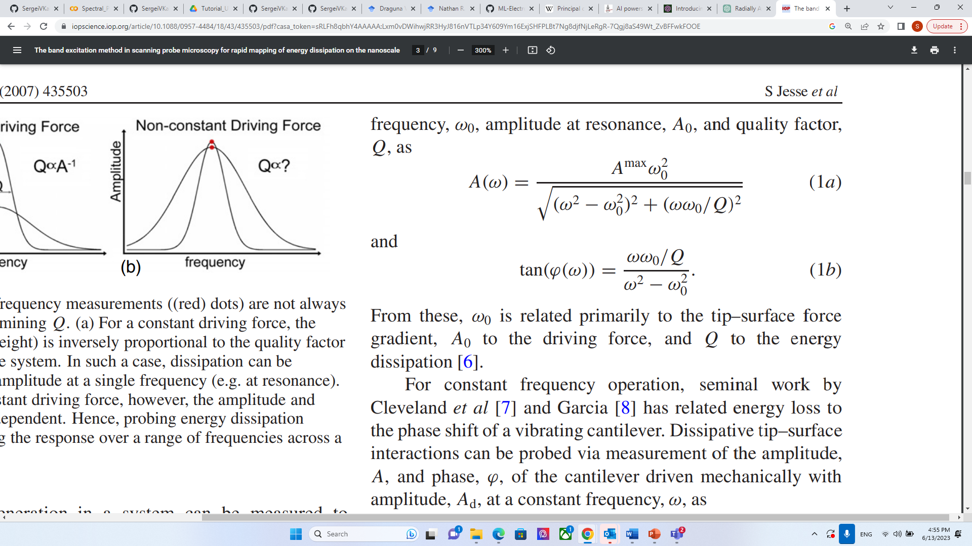
Comparison: PCA vs. functional fit
Band excitation scanning probe microscopy
Signal formation mechanism: simple harmonic oscillator

Slide 20
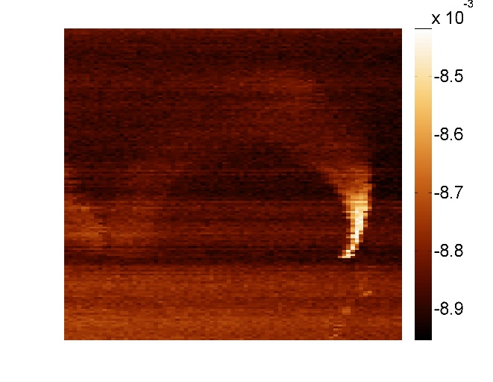
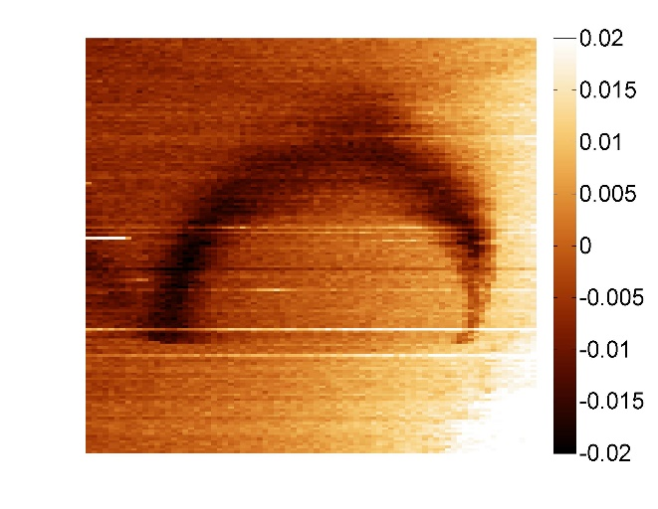
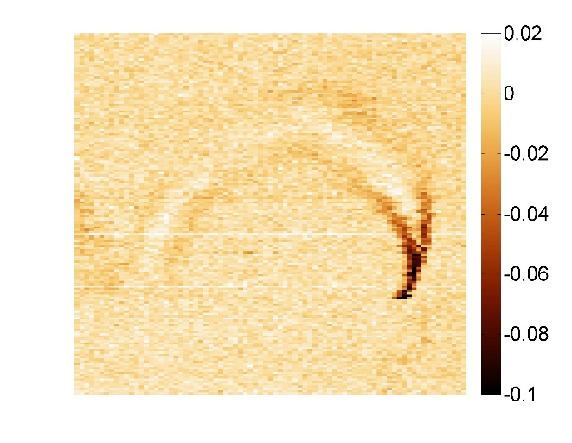
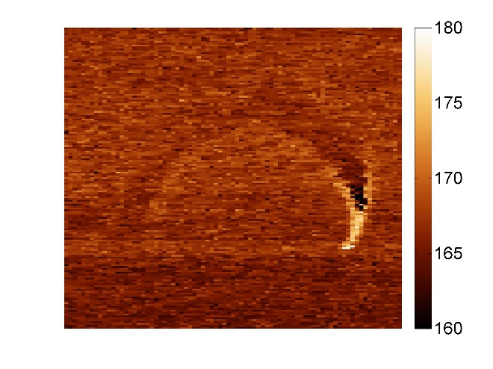
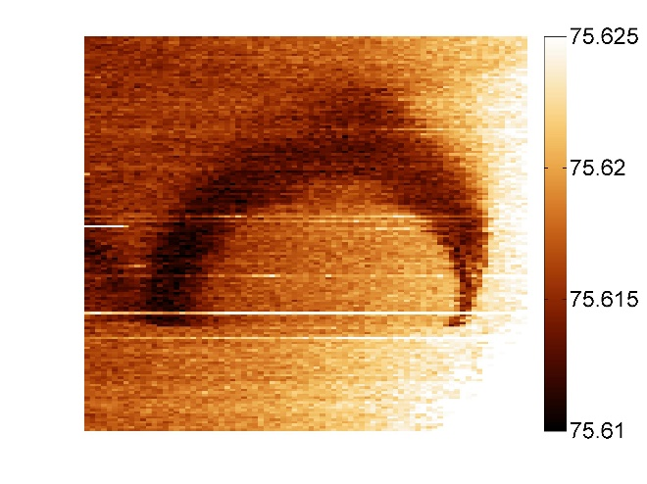
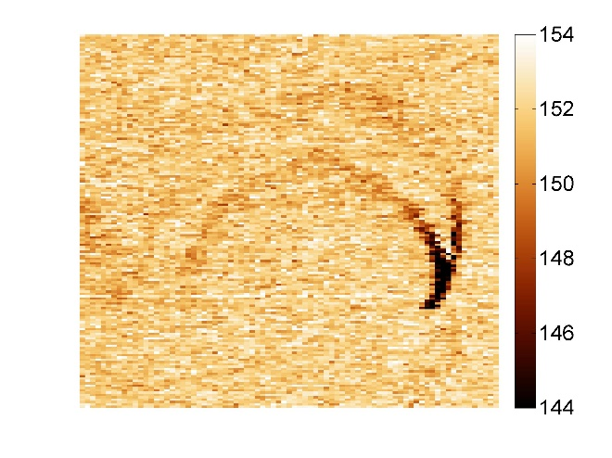
Comparison: PCA vs. functional fit
PC1
PC2
PC3
0.4 sec
Amplitude
Frequency
Q
4 hrs
S. Jesse and S.V. Kalinin, Principal component and spatial correlation analysis of spectroscopic imaging data in scanning probe microscopy, Nanotechnology 20, 085714 (2009).

Slide 21
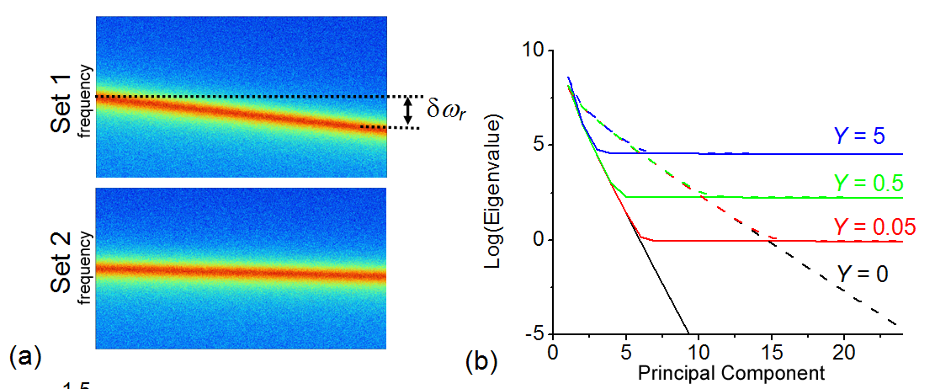
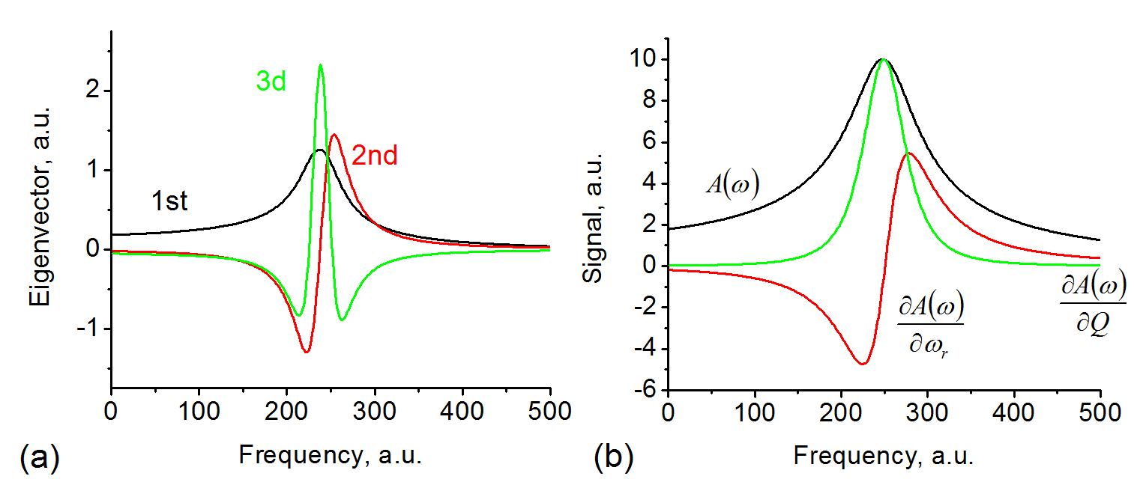
When does PCA match physics?
Simulate simple harmonic oscillator curves for different variations of resonance frequency and noise levels
There is similarity between variational derivatives of SHO responses and PCA eigenvectors
S. Jesse and S.V. Kalinin, Principal component and spatial correlation analysis of spectroscopic imaging data in scanning probe microscopy, Nanotechnology 20, 085714 (2009).

Slide 22
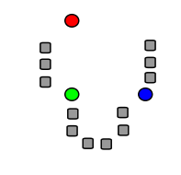
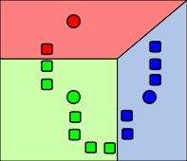
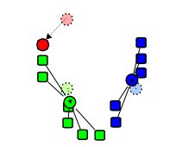
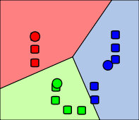
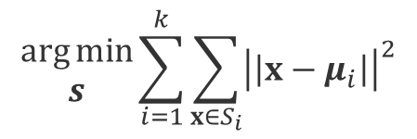
K-mean clustering
PCA is decomposition. But sometimes, we don’t want to decompose our signal, but just group them into ‘alike’ sets.
This is termed ‘clustering’. The easiest and most widely used method is the k-means algorithm
K-means Clustering algorithm, to separate data (x₁,x₂,…,x_{n}) into k clusters
$$\begin{matrix}\arg{min} \\ s\end{matrix}\sum_{i=1}^{k}{\sum_{x∈S_{i}}{{\left|\left|x−μ_{i}\right|\right|}^{2}}}$$
where µ_{i} is the mean of points in S_{i}
(Determine S = {S₁,S₂,…S_{k}}, such that within cluster sum of squares is minimized)
Step 1
Step 2
Step 3
Step 4
Source: Wikipedia

Slide 23
K-means clustering
M. Ziatdinov, A. Maksov, L. Li, A. Sefat, P. Maksymovych, and S.V. Kalinin, Deep data mining in a real space: Separation of intertwined electronic responses in a lightly-doped BaFe₂As₂, Nanotechnology 27, 475706 (2016).
K-means result of the CITS map broken into
three distinct clusters: CITS map of all three clusters combined vs. individual cluster distribution in the map

Slide 24
Independent Component Analysis
PCA: orthogonal transformation of possibly correlated variable into a set of linearly uncorrelated variables
Analyzes data representing observations described by dependent variables which are inter-correlated
Main goal is to find true variables assuming that corrupting noise is Gaussian
ICA” method for separating multivariate signal into additive subcomponents assuming statistical independence of source signals
Finds components that are maximally independent and non-Gaussian
Blind source separation – cocktail party problem
Compared to PCA, ICA can produce statistically independent non-Gaussian components by decorrelating the higher-order moments in addition to the first- and second-order moments of the statistical distribution

Slide 25
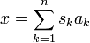
Mathematics of ICA
The Goal is to transform observed data into maximally independent components measured
through some function of independence.
Data as a set of vectors
Components of the data
An observed data vector x can then be represented as a sum of independent components s
weighted by some mixing weight a:
or
In other words, our data vector x is represented by basis vectors
that can form columns of a mixing matrix such that:
https://en.wikipedia.org/wiki/Independent_component_analysis

Slide 26
Mathematics of ICA - 2
Given that our data is set of vectors x, we want to find both, the mixing matrix A and sources s
This can be done by calculating w vectors and a cost function that can maximize the
Non-Gaussianity, or minimize mutual information of
Original sources can then be recovered by multiplying observed data vectors x with the
inverse of the mixing matrix:
Not as easy to utilize as PCA, but excellent premade algorithms are readily available:
Aapo Hyvärinen – FastICA*
RIKEN developed – ICALAB Toolbox
Bell-Sejnowski, Molgedey-Schuster – ICA Toolbox
http://cis.legacy.ics.tkk.fi/aapo/papers/IJCNN99_tutorialweb/IJCNN99_tutorial3.html
http://research.ics.aalto.fi/ica/fastica/

Slide 27
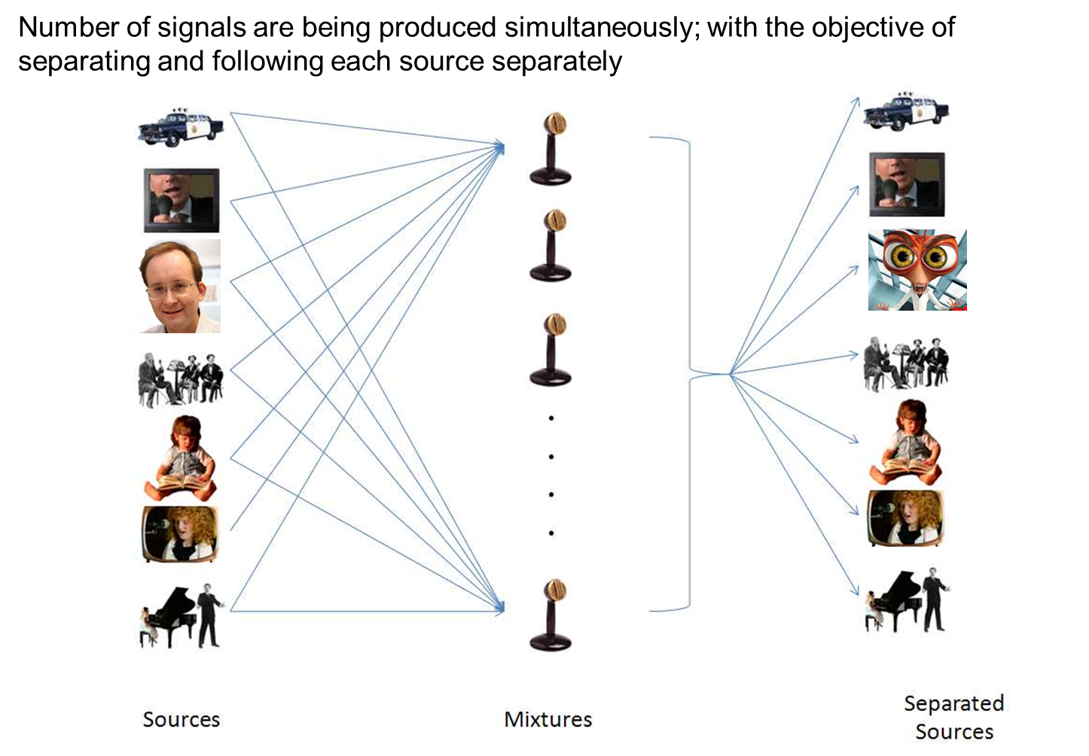
Cocktail Party Problem
Notes:
Ask Alex

Slide 28
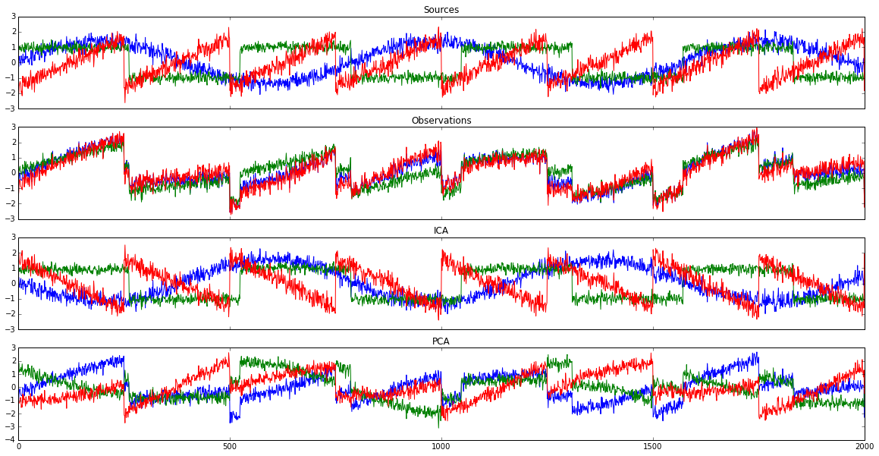
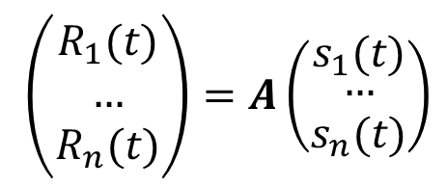
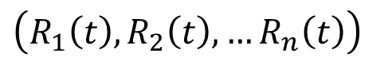
ICA Example
Sources
$\left(R_{1}\left(t\right), R_{2}\left(t\right), …R_{n}\left(t\right)\right)$
Observations
PCA Components
Components are maximally independent
$\left(\begin{matrix}R_{1}(t) \\ … \\ R_{n}(t)\end{matrix}\right)=A\left(\begin{matrix}s_{1}(t) \\ \begin{aligned}… \\ s_{n}(t)\end{aligned}\end{matrix}\right)$
ICA Components

Slide 29
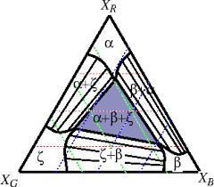
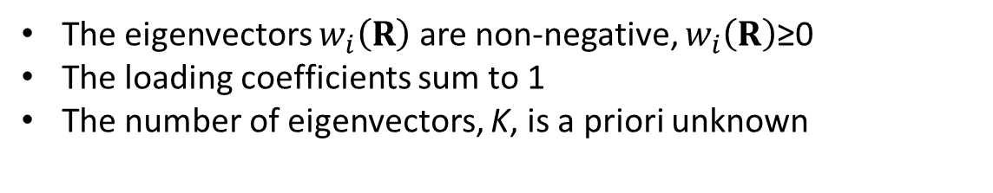
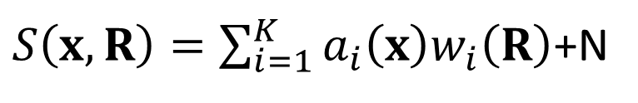
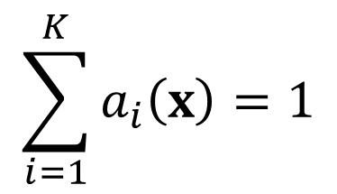
Bayesian Linear Unmixing
$S\left(x,R\right)=\sum_{i=1}^{K}{a_{i}\left(x\right)w_{i}\left(R\right)}$+N
$$\sum_{i=1}^{K}{a_{i}\left(x\right)=1}$$
The eigenvectors $w_{i}\left(R\right)$ are non-negative, $w_{i}\left(R\right)$≥0
The loading coefficients sum to 1
The number of eigenvectors, K, is a priori unknown
BLU is ideally suited for certain classes of problems, e.g. conduction through parallel channels, optical or electronic spectra of mixtures, etc

Slide 30
Dobigeon BLU
Dobigeon presents a Bayesian with a MCMC Gibbs sampler for estimating endmember spectra and its relative abundance in a spectral image
Y = MA + N
Where Y is the noisy observation comprised of endMembers with corresponding Abundances corrupted by additive Gaussian Noise
This algorithm proposes to estimate the initial projection of endmembers in a dimensionality reduced subspace (PCA) via N-FINDR that finds simplex of maximum volume that can be inscribed within the hyperspectral data set using a simple non-linear inversion
Endmember Abundance priors as well as Noise variance priors are chosen by a multivariate Gaussian distribution (this is a nontrivial assumption that rests in computational implementation)
Posterior Distribution is calculated based on endmember independence using Markov Chain Monte Carlo that generates asymptotically distributed samples probed by Gibbs sampling strategy
Nicolas Dobigeon, Saïd Moussaoui, Martial Coulon, Jean-Yves Tourneret, Alfred O. Hero; IEEE TRANSACTIONS ON SIGNAL PROCESSING, VOL. 57, NO. 11, NOVEMBER 2009

Slide 31
Laser heating induced phase transitions
Copper indium thiophosphate (Cu_{0.77}In_{1.12}P₂S₆) layered ferroelectric
Ferroelectric state at room temperature
Curie temperature T_{c} = 320 K
Non-polar In_{4/3}P₂S₆ inclusions
Combined Atomic Force Microscopy (AFM) and confocal Raman spectroscopy investigative approach
AFM – topography measurements
Piezoresponse force microscopy (PFM) – static ferroelectric domain structure
Raman – crystallographic structure via Raman spectra
Experimental scheme
Ferroelectric domain structure
Single point Raman spectra
PFM amplitude
PFM phase
A. Ievlev, ACS Nano 9, 12442 (2015).

Slide 32
Laser heating induced phase transition
Laser can be used for local heating to induce ferroelectric- paraelectric phase transition
Domain structure evolution
Laser power
PFM amplitude
PFM phase
Raman spectra evolution (averaged)
Measurements with variation of the laser power
PFM – in-situ change in the domain structure above T_{c}
Raman – evolution of the Raman spectra through the phase transition
Comprehensive analysis of Raman spectra is complicated by inhomogeneous chemical composition and high noise level
Bayesian Linear Unmixing can be used for automated identification of spectra evolution
A. Ievlev, ACS Nano 9, 12442 (2015).

Slide 33
BLU separation of components
Spatial concentration of components
Results of BLU: components and loading maps
Phase transition
A. Ievlev, ACS Nano 9, 12442 (2015).
Unmixing showed presence of three independent components (contributions into Raman spectra):
Non-polar In_{4/3}P₂S₆ – weak changes in intensity with temperature
Paraelectric CuInP₂S₆ above T_{c} – appears at higher laser powers
Ferroelectric CuInP₂S₆ below T_{c} – disappears at higher temperatures

Slide 34
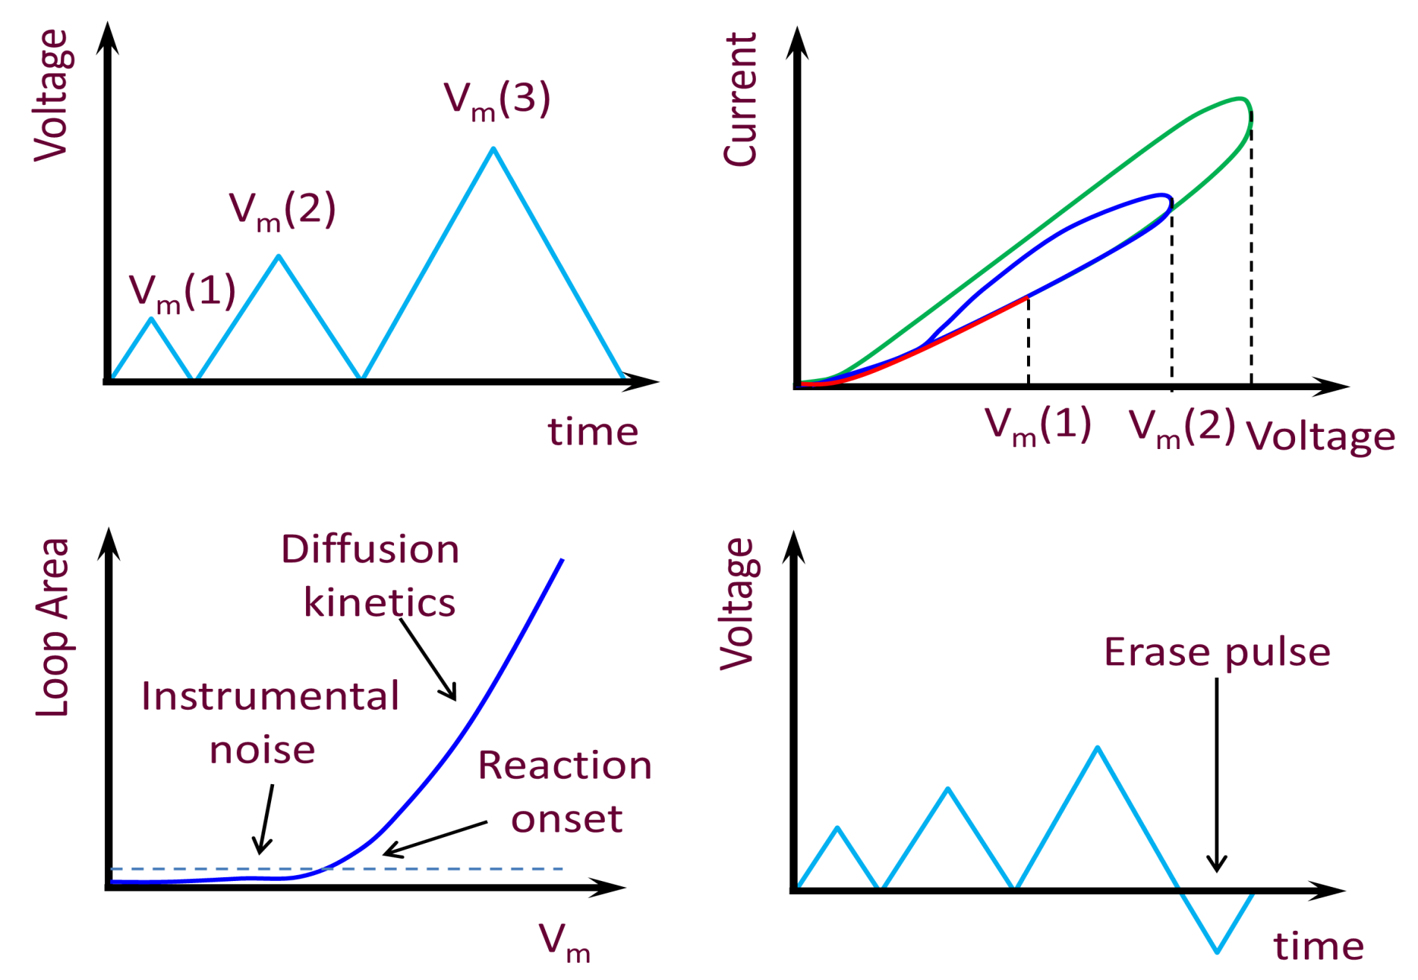
First order reversal curve IV measurements
First order reversal curves in IV measurements
Opening of hysteresis loops indicates onset of slow-bias-induced changes
These can be explored as a function of rate and bias

Slide 35
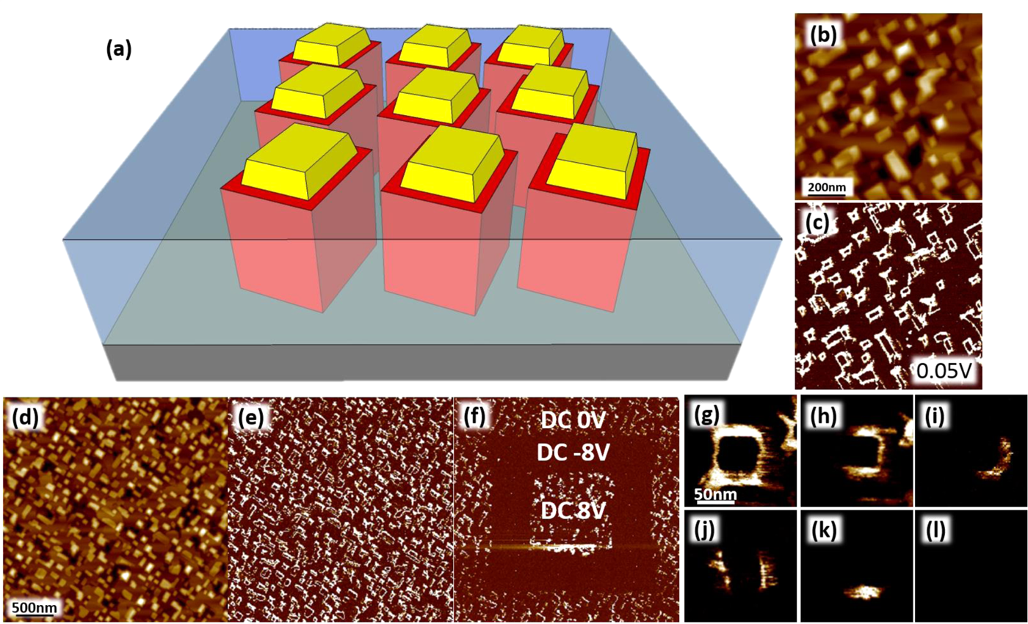
Conductance in nanotubular structures
Probing electrochemistry through electronic degrees of freedom
Y.H. Hsieh, E. Strelcov, J.M. Liou, C.Y. Shen, Y.C. Chen, S.V. Kalinin, and Y.H. Chu, Electrical Modulation of the Local Conduction at Oxide Tubular Interfaces, ACS Nano 7, 8627 (2013).
Topography
CFO
BFO matrix
Current Map
Topography
Current Map
Current Map
Current Map

Slide 36
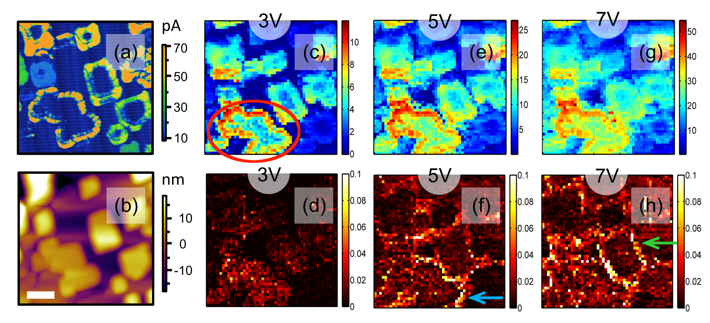


FORC IV of BFO-CFO
Current map @ 0.1 V
Current maps
Averaged IV’s
Topography
FORC-IV Loop area maps
Clear variability of conductance and loop opening behavior
“Too much data” – FORC IV loops that can be reduced to multiple current and loop opening maps as a function of peak voltage
E. Strelcov et al, ACS Nano 8, 6449 (2014).
Notes:
E. Strelcov, A. Belianinov, Y.H. Hsieh, S. Jesse, A.P. Baddorf, Y.H. Chu, and S.V. Kalinin, Deep Data Analysis of Conductive Phenomena on Complex Oxide Interfaces: Physics from Data Mining, ACS Nano 8, 6449 (2014).

Slide 37



Bayesian linear unmixing
Ohmic
Non-linear
Low conductivity
Memristive
E. Strelcov, A. Belianinov, Y.H. Hsieh, S. Jesse, A.P. Baddorf, Y.H. Chu, and S.V. Kalinin, Deep Data Analysis of Conductive Phenomena on Complex Oxide Interfaces: Physics from Data Mining, ACS Nano 8, 6449 (2014).
BEI₁
BEI₂
BEI₃
BEI₄
Endmembers
Loading Maps
Separates 4 different types of behavior, all making physical sense. Loading maps normalized to unity.
Notes:
E. Strelcov, A. Belianinov, Y.H. Hsieh, S. Jesse, A.P. Baddorf, Y.H. Chu, and S.V. Kalinin, Deep Data Analysis of Conductive Phenomena on Complex Oxide Interfaces: Physics from Data Mining, ACS Nano 8, 6449 (2014).

Slide 38




Fit to physical models
Fowler-
Nordheim
Poole-
Frenkel
Mott-
Gurney
Child’s
Law
Mechanism\
Endmember
Schottky
BEI₂ to FN
BEI₄ to FN
BEI₄ to PF
BEI₃ to FN
E. Strelcov, A. Belianinov, Y.H. Hsieh, S. Jesse, A.P. Baddorf, Y.H. Chu, and S.V. Kalinin, Deep Data Analysis of Conductive Phenomena on Complex Oxide Interfaces: Physics from Data Mining, ACS Nano 8, 6449 (2014).
Notes:
E. Strelcov, A. Belianinov, Y.H. Hsieh, S. Jesse, A.P. Baddorf, Y.H. Chu, and S.V. Kalinin, Deep Data Analysis of Conductive Phenomena on Complex Oxide Interfaces: Physics from Data Mining, ACS Nano 8, 6449 (2014).

Slide 39
FORC IV workflow

Slide 40
Wait, there is more!
We need un-mixing/decomposition that are infused in some universal manner with a priori physical information (trivial example is constraints, a less trivial one is a simulation of some expected components) so that the resultant components can be directly interpreted in physical terms.
For example:
Bayesian linear unmixing: constraints on endmembers
Sparse reconstructions: small number of components in each point
Constraints on loading maps: smoothness or sharp boundaries
Kernel transforms: data is simplest if physics is correct

